Slide 1
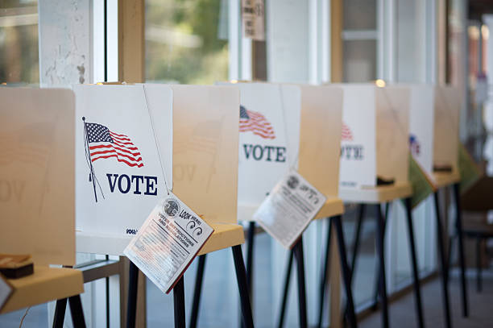
Healthcare and VOTER Support
Adrian Pascual: BlueLabs Fellowship 2019 Capstone
BlueLabs | Test Everything, Change Behavior, Drive Results.
www.bluelabs.com

Slide 2
Healthcare in the U.S.
HEALTHCARE WAS THE NUMBER ONE ISSUE FOR VOTERS IN 2018
According to a variety of exit polls and other surveys in 2018, healthcare was top of mind for voters when deciding who to support in the midterms. Democrats responded by heavily focusing their messaging on healthcare.
INSURANCE COVERAGE RATES ARE STAGNATING
From 2010 to 2015, the percentage of people without health insurance dropped from 16.3% to 9.1%. However, since 2015 the uninsured rate has hovered around the 8-9% range without any significant changes. One contributing factor could be that 13 states still refuse to expand Medicaid after the ACA.
HEALTHCARE COSTS CONTINUE TO RISE
The Centers for Medicaid and Social Services report that from 2011 to 2017, healthcare costs per capita rose 27%.

Slide 3
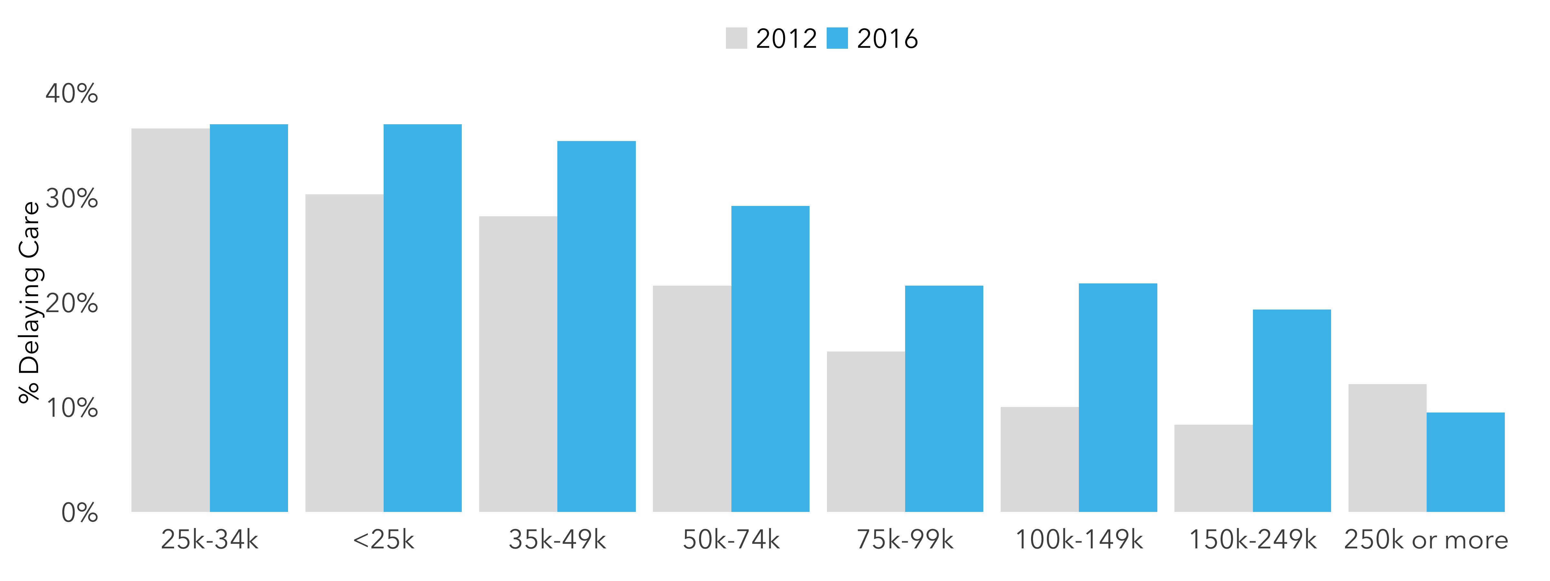
Delaying Care and Income
Almost all income groups are more likely to delay healthcare now than in 2012. Middle income voters are particularly impacted as they do not qualify for government sponsored healthcare through the ACA or Medicaid.

Slide 4
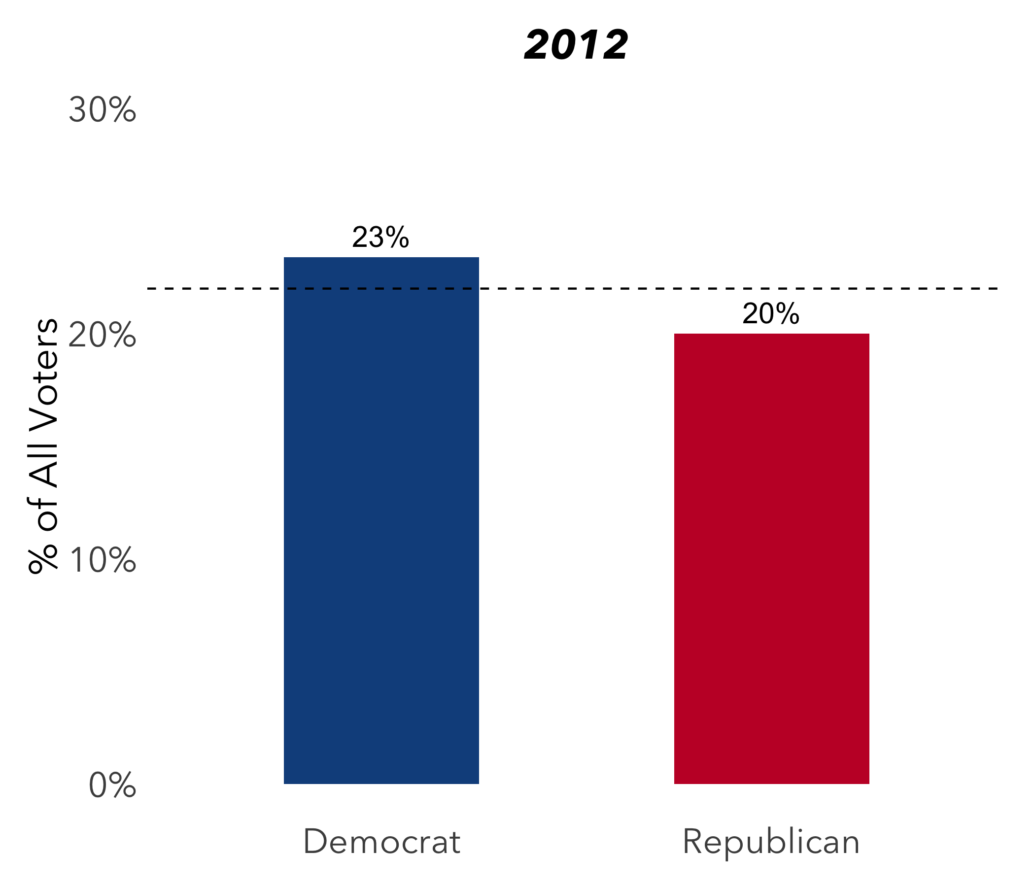
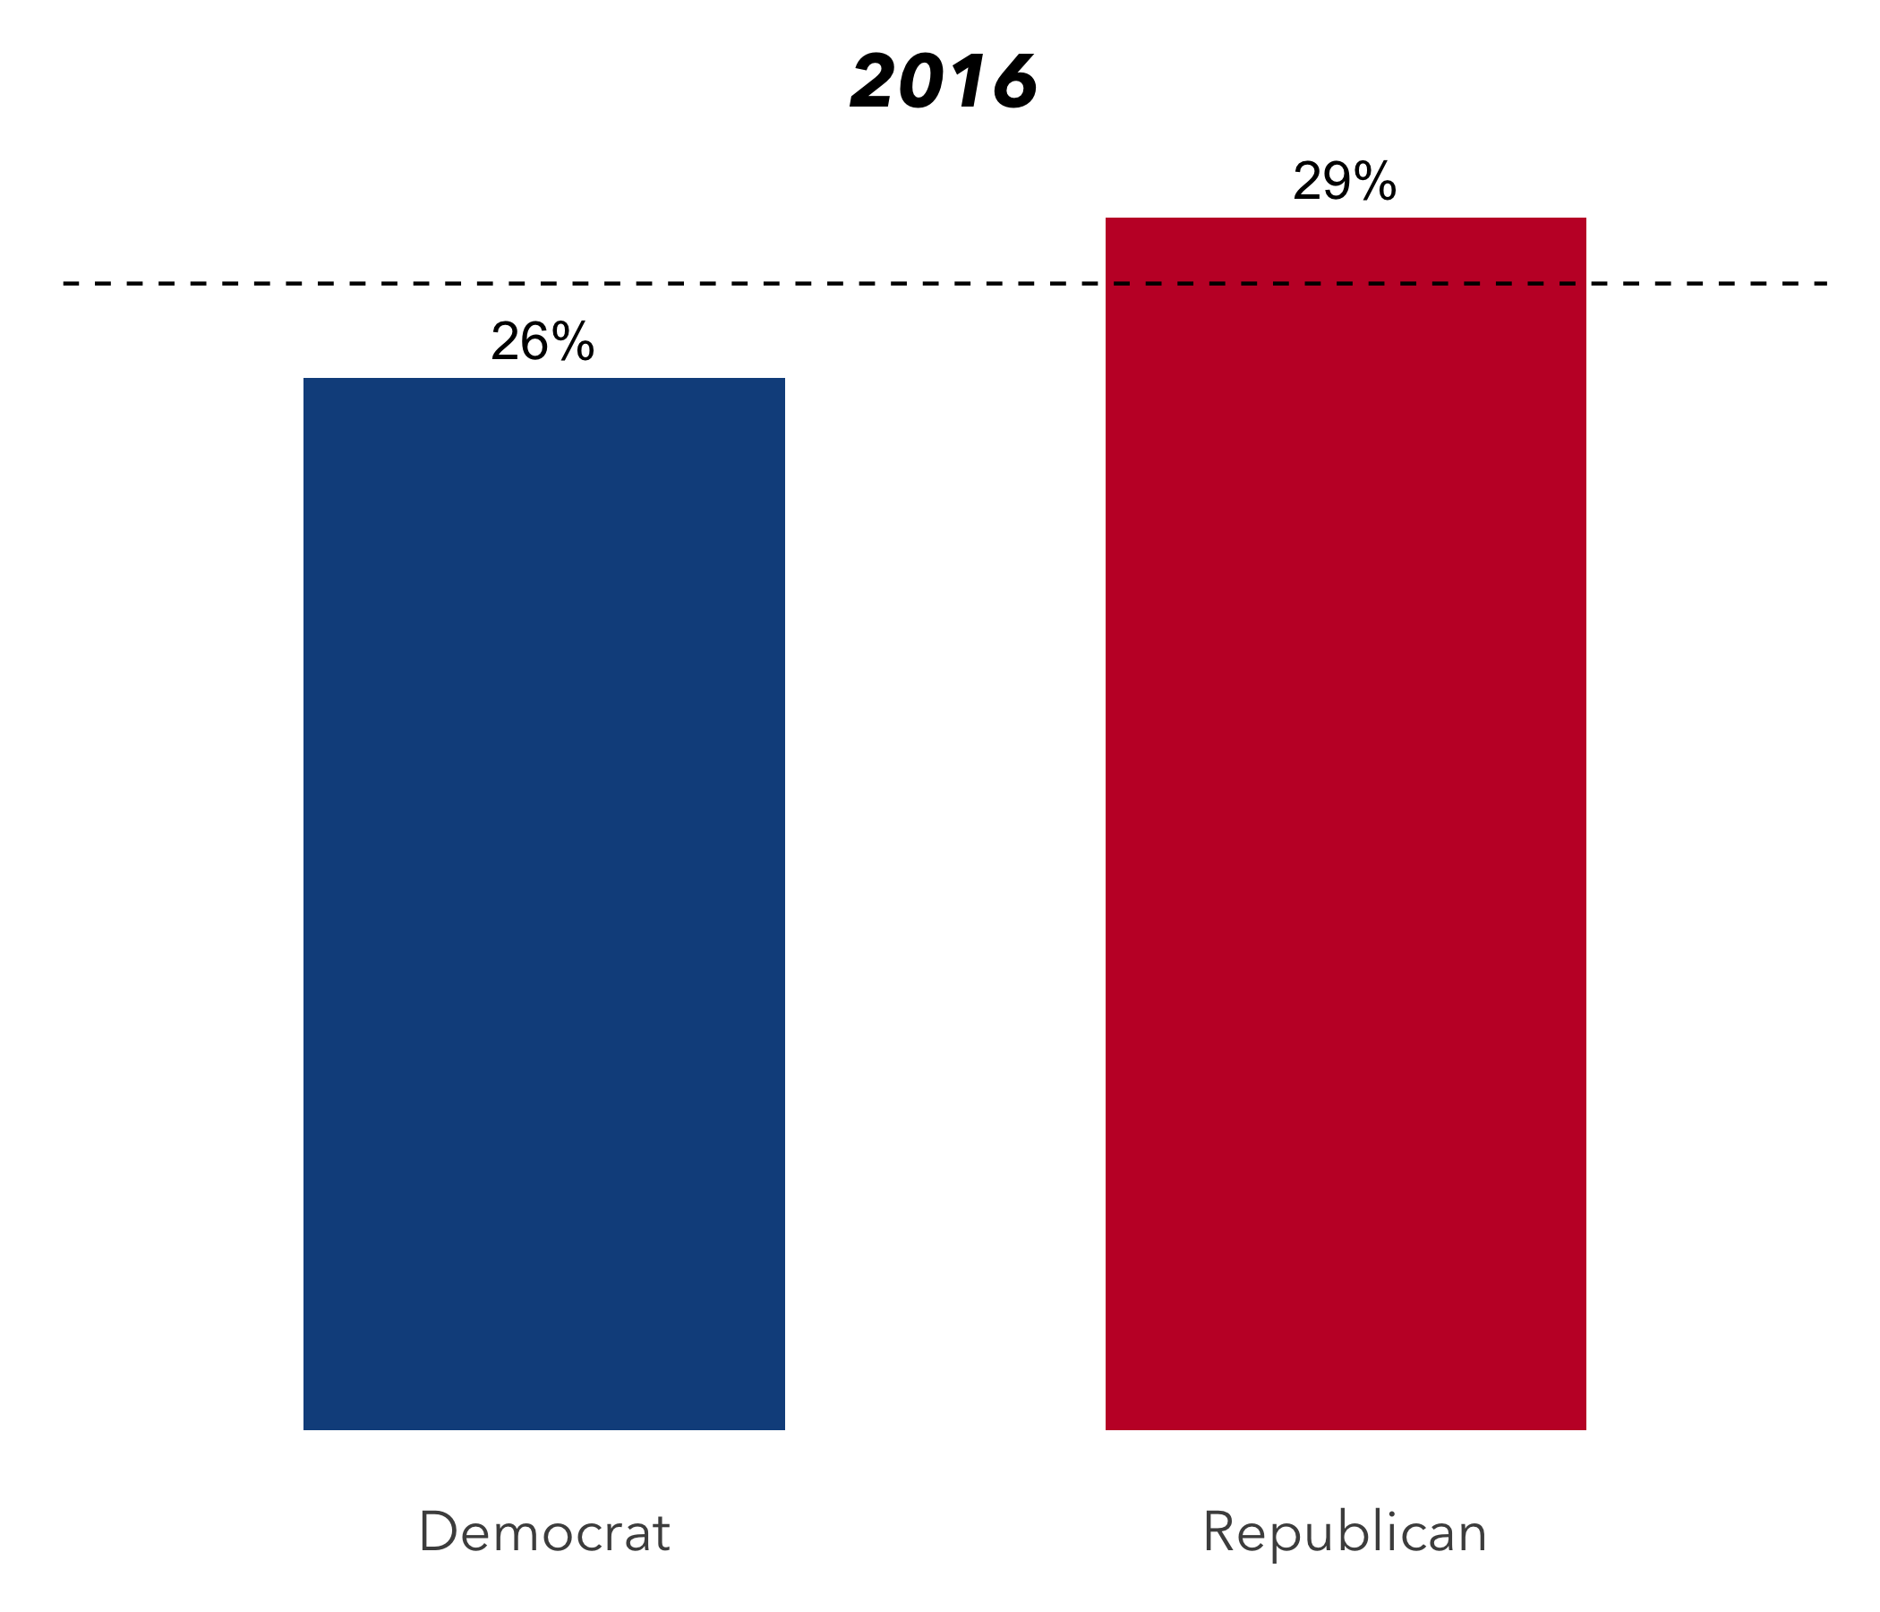
Delaying Care and Voting
Partisan splits in who delayed care flipped from 2012 to 2016, but margins were small in both cases. This change is likely due to changes in the types of voters who qualify for government subsidized healthcare. In states that expanded Medicaid, delay of care is reduced, leading to fewer Democratic areas with high uninsured rates.
2016 Average
2012 Average

Slide 5
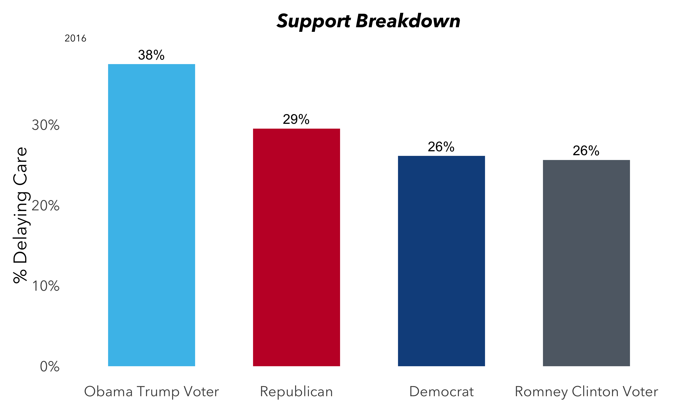
Obama-Trump Voters
Obama – Trump voters were particularly likely to report delaying care.
Almost 40% of these voters delayed healthcare in 2016, compared to lower delay rates for average Democrats and Republicans.

Slide 6
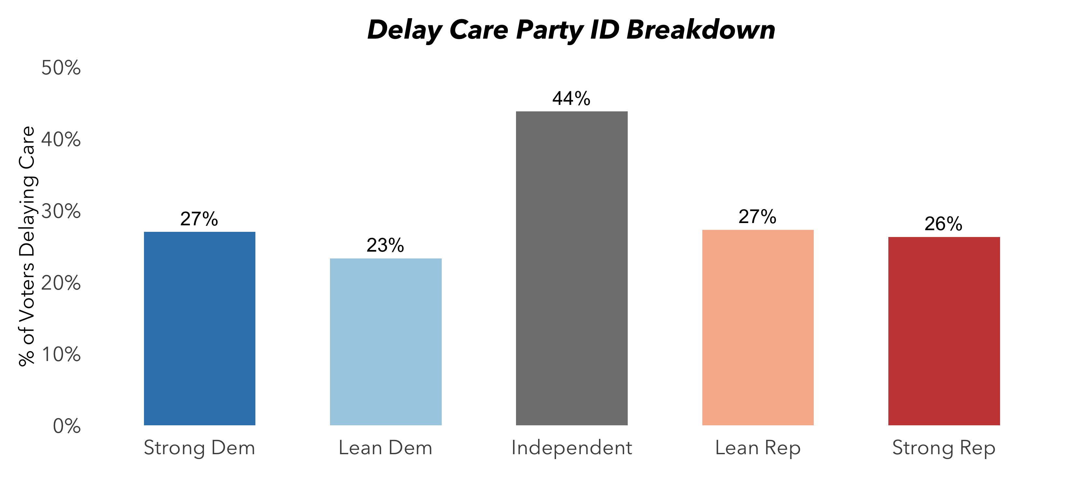
Independents
Among all partisan groups, self-described Independent voters are the most likely to delay care. This group is also the most likely group of partisans to swing from Obama to Trump.

Slide 7
Talking About Healthcare
Views on the ACA are driven in large part by partisanship. Republicans are less likely to approve of the ACA than Democrats. That said, a variety of individual provisions of the ACA – particularly those directly addressing pocket-book issues – are popular across party lines.
Americans’ Opinions of ACA Provisions
Percent who say they have a FAVORABLE opinion of each of the following provisions of the law: | Total | Democrats | Indies | Republicans
Allows young adults to stay on their parents’ insurance plans until age 26 | 82% | 90% | 82% | 66%
Creates health insurance exchanges | 82% | 91% | 78% | 71%
Provides financial help to low and moderate income Americans | 81% | 92% | 82% | 63%
Gradually closes the Medicare prescription drug “doughnut hole” | 81% | 85% | 82% | 80%
Eliminates out-of-pocket costs for many preventive services | 79% | 88% | 78% | 68%
Medicaid Expansion | 77% | 91% | 77% | 55%
Requires employers with 50 or more employees to pay a fine if they don’t offer health insurance | 69% | 88% | 61% | 56%
Prohibits insurance companies from denying coverage because of a person’s medical history | 65% | 70% | 66% | 58%
Increases the Medicare payroll tax on earnings for upper-income Americans | 65% | 77% | 69% | 42%

Slide 8
Conclusions
HEALTHCARE CONTINUES TO BE A KEY CONCERN FOR AMERICAN VOTERS
Voters in 2018 put a large emphasis on healthcare and Democratic campaigns responded in kind in campaign messaging. While partisanship dominates discussion of policies like the ACA, voters of all stripes struggle with delay of care decisions.
HEALTHCARE TOUCHES KEY SEGMENTS OF VOTERS
Obama-Trump voters and self-reported Independent voters are two segments of voters who have been particularly impacted by delay of care decisions. Reaching these voters in 2020 will likely be important to winning back the White House and in down-ballot races.
CHALLENGES ANALYZING ACCESS TO CARE
The key questions here are only asked in two ANES surveys, so sample sizes are somewhat small – particularly in essential subgroups like Obama-Trump voters. Accruing more data will allow us to make more fine grained estimates of the impact of delay of care decisions on vote choice.

Slide 9

GET IN TOUCH!
CONTACT INFO
linkedin.com/in/adrian-pascual
https://github.com/local-adrian/

Slide 10
Appendix: Data Overview
Data was collected from the American National Election Studies (ANES) Survey for 2012 and 2016. 10,184 responses and 2000+ variables were filtered to only include respondents who had voted in the election year in which they were surveyed.
Variables Measured
Delaying Healthcare
Affordable Care Act Support
“During the past 12 months, have you or anyone living here put off getting this kind of health care because of the cost?
“How much do you favor/ oppose the health care reform law of 2010?”
Party Identification
Turnout
Summary of three questions on party preference and identification
“How about the election for President? Did you vote for a candidate for President?”
Vote Choice
”For whom did you vote for President?
Affording Healthcare
Age, Race, Income, Education, Gender
“During the next 12 months, how likely is it that you will be able to pay for all health care costs?”
Grouped into standard buckets

Slide 11
Appendix: Sources
Inspiration for research: Ziegenfuss, Jeanette Kane, Micahel Davern, and Lynn A. Blewett. "Access to health care and voting behavior in the United States." Journal of health Care for the Poor and Underserved 19.3 (2008): 731-742.
AP 2018 midterm election poll results: https://apnews.com/222fd1571d744aec903604542eb11b70
Healthcare costs per capita and population insurance rates: https://www.census.gov/library/publications.html
ANES Survey Data (2012/2016): https://electionstudies.org/
Crosstabs for the analysis: https://docs.google.com/spreadsheets/d/1Dj4MGMqVhuwUHXseK-JETvqgfU1WE8QKrGq8DwfAPEQ/edit?usp=sharing
Github Repo with R, SQL, and Python code: https://github.com/adrian-pascual/BlueLabs_Capstone
Kaiser Family Foundation Source: https://www.kff.org/health-reform/poll-finding/kff-health-tracking-poll-november-2018-priorities-congress-future-aca-medicaid-expansion/

